Slide 1
Ann Barrett (CFD), Danielle Froio (CFD), Michelle Richardson (CFD)
Update on Long-Term Vitamin Stabilization Work for NASA
25 October 2016

Slide 2
NASA Research Progress
Into the third year of an effort focused on preserving vitamin activity LONG-term:
“Stabilized Foods for use in Extended Spaceflight: Preservation of Shelf-Life, Nutrient Content and Acceptability”

Slide 3
Project Rationale and Objectives
Planning for possible future manned missions to Mars: Need 5 year shelf stability (i.e., no resupply…)
Need to maintain astronaut health (vitamin activity is necessary for neural functioning, immunity, resistance to oxidation, etc)
Need to maintain consumption of high quality food
Two research thrusts:
Effects of matrix composition/polarity on vitamin stability
Effects of advanced processing and packaging technologies on vitamin stability

Slide 4
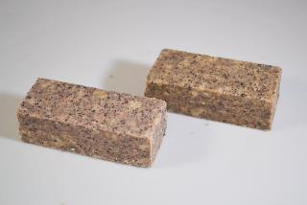
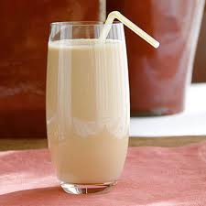
Experimental Scheme—Part 1: Matrix Effort
Vitamins A, B1, B9, C and E
Encapsulated in either polar or non-polar materials (i.e., starch vs. lipid shells)
Incorporated into polar and non-polar food matrices in compressed vs. particulate form, at fortification levels 2X the Space Flight Requirement)
Lipid encapsulated vitamins in low-fat products; starch-encapsulated vitamins in high-fat products =>
Four samples (2 matrix forms X 2 matrix polarities) selected for multi-year testing

Slide 5
Storage Results
Samples were maintained at 70F (NASA requirement) for 2 years (so far), and also at 100F (accelerated) for 1 year.
Again:
High fat bar (starch-encapsulated vitamins)
Low fat bar (lipid-encapsulated vitamins)
High fat drink mix (starch-encapsulated vitamins)
Low fat drink mix (lipid-encapsulated vitamins)

Slide 6
Vitamin Loss After 2 Years

Slide 7
Water Soluble Vitamins 1 year, 100F
UNCLASSIFIED #U16-532

Slide 8
Fat Soluble Vitamins 1 Year, 100F

Slide 9
General Observations About Vitamin Loss
On average, vitamin loss susceptibility follows the sequence:
A ~ B9 > C ~ B1 > E
So far:
On average, better stability in bars, which are packaged with oxygen scavengers
Vitamin E is extremely stable
Vitamin A has the most susceptibility to high temperature storage

Slide 10
Sensory Quality/Acceptance: Overall Quality, 9-point hedonic scale
Product High Fat Low Fat
Bar, 70F 6.42 6.13
1 Year
Bar, 100F 5.58 5.46
1 Year
Drink Mix, 70 F 6.82 6.03
1 Year
Drink Mix, 100F 6.37 5.46
1 Year

Slide 11
Sensory Quality/Acceptance: Overall Quality, 9-point hedonic scale
Product High Fat Low Fat
Bar, 70F 6.16 5.74
2 Years
Drink Mix, 70 F 6.46 6.07
2 Years

Slide 12
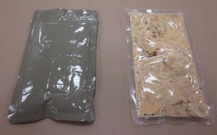
Recap Experimental Scheme—Packaging Effort
Evaluate innovative packaging materials (high barrier, transparent packaging materials)
Determine critical performance properties (O2 transfer rate, water vapor transfer rate, mechanical strength)
Evaluate innovative, quality-preserving processing technologies: High-Pressure, Microwave, Irradiation sterilization
Determine vitamin content of model food (Cajun Chicken Pasta) packaged in these materials and processed, throughout prolonged storage (6 months, 1 and 2 years)
Test Pouches
Manufacturer | Coating Material | Pouch ID
Kuraray America | Nanocomposite | A
Toppan Printing Co | Aluminum oxide | B
Rollprint | Aluminum oxide | C
(a) (b)
(a) Aluminum foil based pouch and (b) Aluminum oxide coated pouch

Slide 13
(1) Pouch Performance Assessment
Pouch Samples | Durability during Shipment / Processing | Seal Strength | Mechanical Properties | Oxygen Barrier | Water Vapor Barrier | Overall Quality (Food)
Foil "Retort" Pouch | ++++ | ++++ | +++ | ++++ | ++++ | ++
Pouch A | ++ | ++ | ++ | ++ | + | ++++
Pouch B | +++ | +++ | ++++ | +++ | +++ | +++
Pouch C | + | + | + | + | ++ | +
Of the test pouches, Pouch B showed best overall mechanical and barrier properties, second to the control foil pouch

Slide 14
(2) Processing Studies
Selection of specific pouch/processing combinations based on pouch mechanical integrity and preliminary sensory data of product.
Initial vitamin and sensory testing.
Ongoing storage studies.

Slide 15
(3) Initial Results
Comparing processes (before storage):
- MATS may help to preserve vitamins
- Irradiation is most harmful to vitamins

Slide 16
Additional Research with NASA
Meal Replacement Effort
Compression research
Replacement of ISS breakfast items with compressed bars
Successful development of prototypes
New compression technology:
Ultrasonic Compression

Slide 17
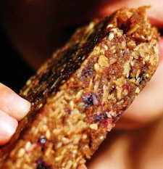
Ultrasonic Compression Molding
Ultrasonic Agglomeration
(Contract w/Creative Resonance)
Conventional Compression
(in-house)
Benefits of Ultrasonic Agglomeration
Eliminates need for binders
Mechanically robust products
Volume reduction
Particulates visible
Pasteurization effect
Notes:
Agglomeration, the sticking of particles to one another or to solid surfaces, is a natural phenomenon. For powders and bulk solids, agglomeration can be unwanted, resulting in uncontrolled buildup, caking, bridging, or lumping. It can also be a beneficial process, utilizing the controlled enlargement of particles to improve powder properties and obtain high-quality products.
Ultrasonic agglomeration involves the high-frequency sound waves, projected towards the target particles for causing them to clump together.
To control the binding of fragmented food, it involves the careful modulation of the sound
Sonic and ultrasonic energy can cause agglomeration of particles

Slide 18
THANK-YOU!

