Slide 1
Research and Development Associates 71st Meeting 2016
“The Evolving AOR”
And Army Food Service Transformation
Ms. Cara Vartuli-Dusablon
Division Chief
Concepts, Systems, and Policy Division Joint Culinary Center of Excellence (JCCoE)
ACES Operations Directorate

Slide 2
Agenda
References
Goals
Future/ AOR
JCCoE updates
Army Food Service Transformation
Questions

Slide 3
References
Army Regulation 30-22
Department of Army Pamphlet 30-22
www.apd.army.mil
Doing Business with the Army Food Program
http://www.quartermaster.army.mil/jccoe/publications/sop/Doing_Business_Army_Food_ProgramDec2007.pdf.quartermaster.army.mil/jccoe
DA CONOPS Menu available on the JCCoE web page, varies by theater
Army Buyer’s Guide; STANDARD!

Slide 4
Goals
Change the face of today’s Army Food Program
Be flexible
Spend efficiently and effectively

Slide 5
FUTURE
AOR:
Be aware of the moving target, headcounts will change
New AOR locations
Understand the Army’s goals in drawdown operations in Afghanistan
Change in personnel

Slide 6
FUTURE
AOR:
Next FSMB
Sampling of products
Remember the three questions
Is it cheaper?
Is it better?
Is it innovative?
Don’t stock pile inventory
Monitor ordering patterns
Monitor changes based on season

Slide 7
Recommendations
Army Buyers Guide:
Read the Army Buyers Guide
Standards
Grade A
NAMP
USDA, USDC
Read “Doing Business with the Army”

Slide 8
JCCoE Updates
Uniform
In production
Fielding projected for 3rd and 4th quarter 2016 to nine installations
Army Buyers Guide
Under revision
Working on a joint guide for all the services

Slide 9
JCCoE Updates
DFAC Transition
“New” locations, schedules, menus
Utilize EXORD feedback to tailor locations, potential closure/consolidation of DFACs
Goal is to change the face of Army Food Service while maintaining quality product and service
Consulting contract began in Nov of 2016 and expired Oct 2016
Pilot location(s)
Fort Stewart

Slide 10
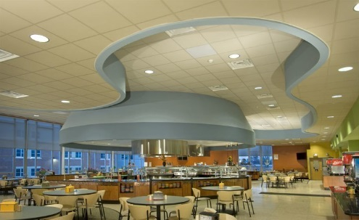
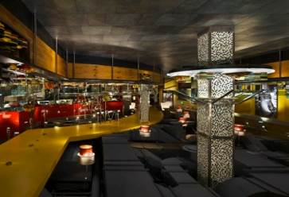
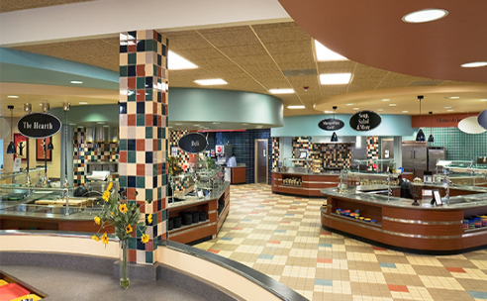
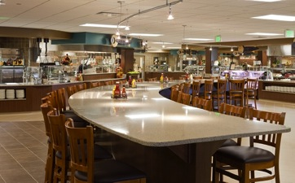
Army Dining Facility Transformation
Description: Provide Soldiers with wider, quality food choice options closer to where they work & live and that meet Soldier nutritional and commander goals
Key Outcomes Demonstrated:
Improved millennial Soldier satisfaction
Improved, modernized Army food dining services
Extended hours for Soldier meals IAW mission needs
Facts:
Dining options are not viable for Initial Entry Soldiers based on TRADOC POI
DAG-4 has already awarded a contract to develop campus-style, multi-option branded feeding options for Soldiers
Potential Benefits Cont:
Improved service delivery to increase DFAC use
Enhance Soldier cognitive & Physical performance
Deliver service at a lower cost
Nest Go For Green® with the Performance Triad
Challenges:
Multi-Option meal dining could result in unsustainable costs to deliver service
Army could experience difficulties in resourcing transformation of DFACs and other dining services
Potential Benefits:
Infrastructure sized to SIK population w/ ability to expand to serve other authorized patrons
Better meals that Soldiers desire; Increase Commander’s flexibility

Slide 11
Army Dining Facility Transformation
Branding Concepts – Same across the Army
Dining Facilities - Station Feeding Concepts
G-Store - Army Brands for Consistency
Kiosk – Limited Menu Options – Improved Location (Population Centers)
Mobile Feeding Options
Consultant Contract
Industry partnership
Provides expertise to ensure success
TRADOC Enterprise Contract
Centralized contract - Potential Cost Efficiencies
Possible reduction of duplicate overhead at each Installation
POC: Stephen J. Primeau, Stephen.j.primeau.civ@mail.mil, 804-734-4836
As of: 13 September 2016

Slide 12
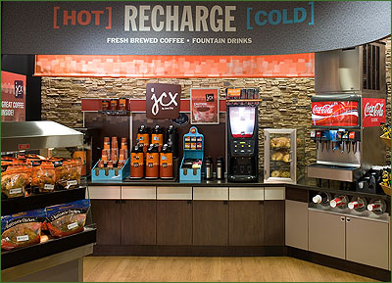
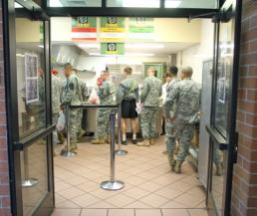
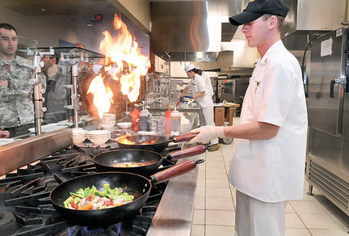
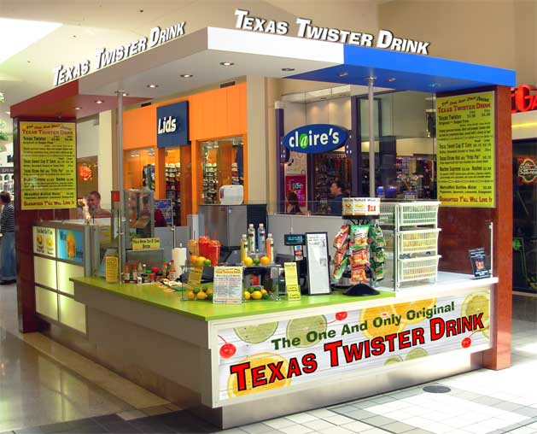
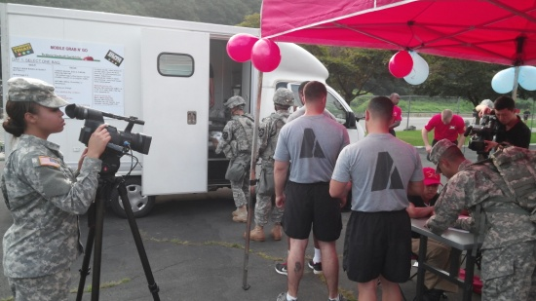
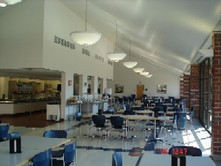
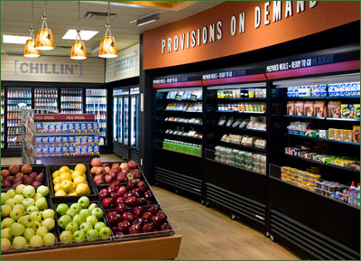
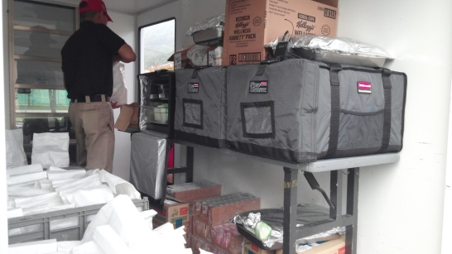
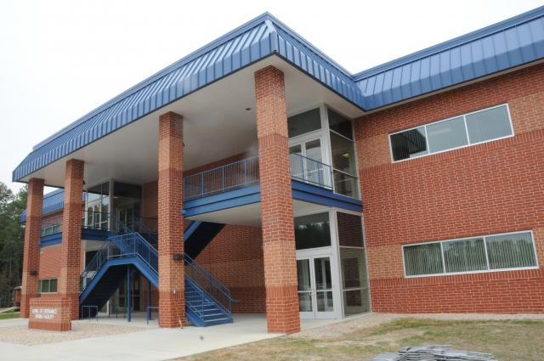
Army Dining Facility Transformation
G-Stores/Kiosks
“Grab N Go”
Dining Facilities
POC: Stephen J. Primeau, Stephen.j.primeau.civ@mail.mil, 804-734-4836
As of: 13 September 2016

Slide 13
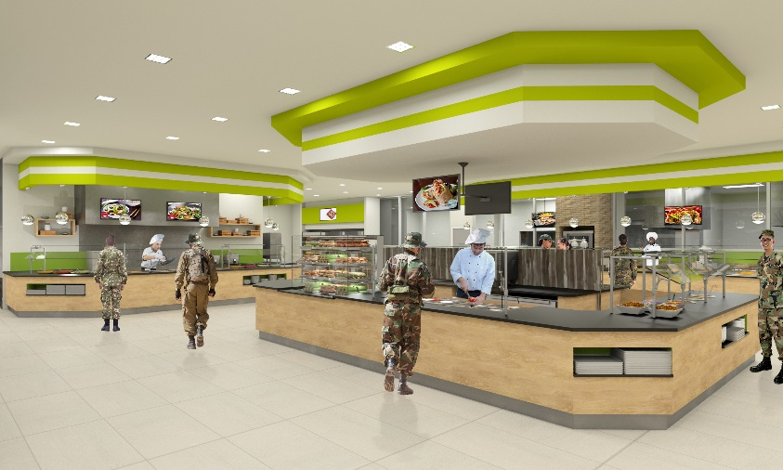
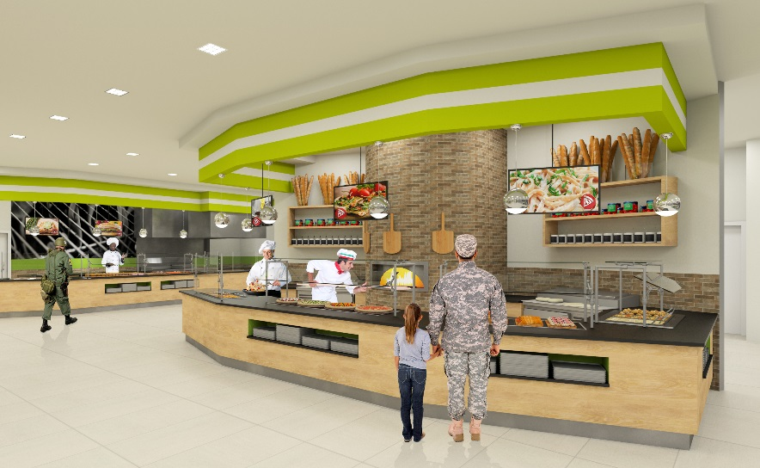
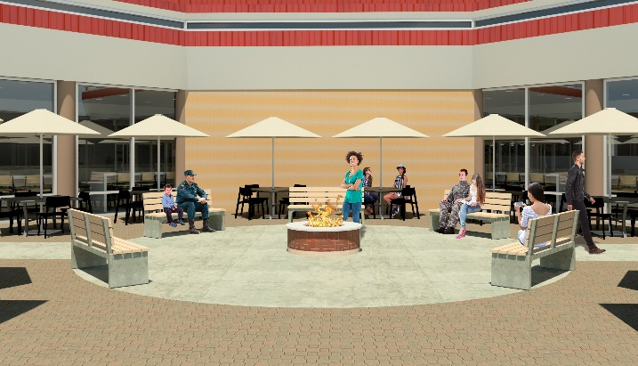
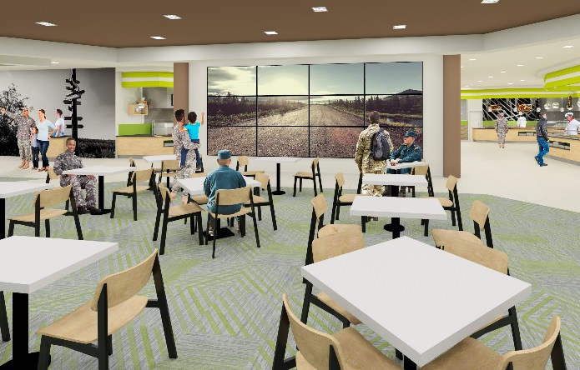
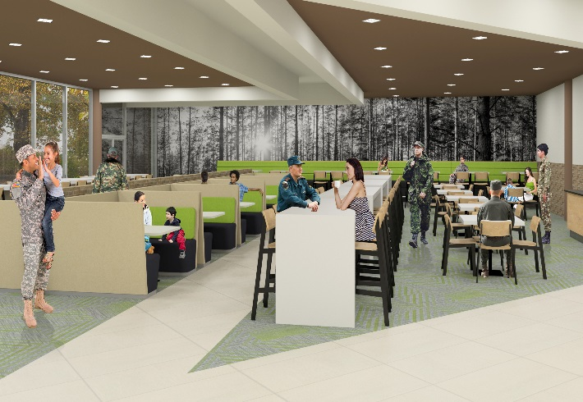
Army Dining Facility Transformation
Dining Facility Station Feeding Design
POC: Stephen J. Primeau, Stephen.j.primeau.civ@mail.mil, 804-734-4836
As of: 13 September 2016

Slide 14
