Slide 1
Subsistence
SUPPLIER OPERATIONS
SUPPLIER SUPPORT DIVISION
Quality Audits & Food Defense Update
October 25, 2017
FALL R&DA – San Antonio, TX
Presented by John King

Slide 2
FOOD SCIENTIST

Slide 3
Rations & Equipment Technical Branch
Food Technologists & QAS’s provide pre- and post-award support to rations contracts
Entomologist support for Subsistence manufacturing & storage facilities and other supply chains, on request
Value Engineering support
Food Service Equipment support for DFACs & Galleys ashore & afloat
Field Feeding Equipment support for expeditionary kitchens & feeding
Subject Matter Experts for Entomology, Food Science, Food Inspection, Equipment and Value Engineering

Slide 4
OPERATIONAL RATIONS AND
EQUIPMENT TECHNICAL BRANCH
John King, Branch Chief-FTSC
Individual Rations
Brian Lowry – QAS
Keith Pritts – Food Technologist
CW3 Eugene Garcia - AVI
Group Rations
Ramona Hemphill – Food Technologist
Shannon Dempsey – QAS
Program Support – Monographs/Engineering Support/Etc.
Clem Galligan – QAS
Foodservice Equipment – DFAC/Galley/Ships/Etc.
Roberto Santisteban – QAS
Troy Smith – QAS
Dennis Conk – QAS
Field Feeding Equipment
Vacant

Slide 5
MRE Assemblers
Quality System Plans, QS Compliance Audits, Product Acceptability and FDP Compliance Ratings
Product Acceptability – MRE 37
January - October 2017

Slide 6
RATION RETORT PRODUCERS
Quality System Plans, QS Compliance Audits, Product Acceptability and FDP Compliance Ratings
Product Acceptability – MRE 37
January - October 2017

Slide 7
COMPONENTS PRODUCERS
Quality System Plans, QS Compliance Audits, Product Acceptability and FDP Compliance Ratings
Product Acceptability – MRE 37 / non-retorted Ration components
January - October 2017

Slide 8
Operational Rations (MRE) -
Quality System Plans, QS Compliance Audits and Product Acceptability Ratings
*January through October 2017 Minimum Acceptability > 90%

Slide 9
WEBSITES
DLA TROOP SUPPORT SUBSISTENCE
http://www.dla.mil/TroopSupport/Subsistence.aspx
Operational Rations
http://www.dla.mil/TroopSupport/Subsistence/Operationalrations.aspx
Foodservice & Field Feeding Equipment
http://www.dla.mil/TroopSupport/Subsistence/Foodserviceequipment.aspx
Value Engineering
http://www.dla.mil/TroopSupport/Subsistence/valuemgmt.aspx

Slide 10
QUESTIONS?

Slide 11
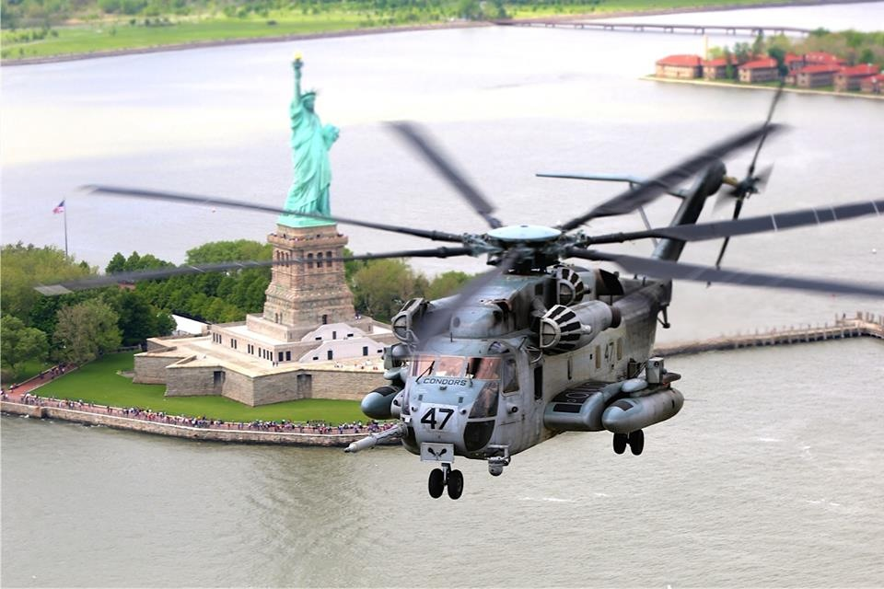
Thank you

