Slide 1
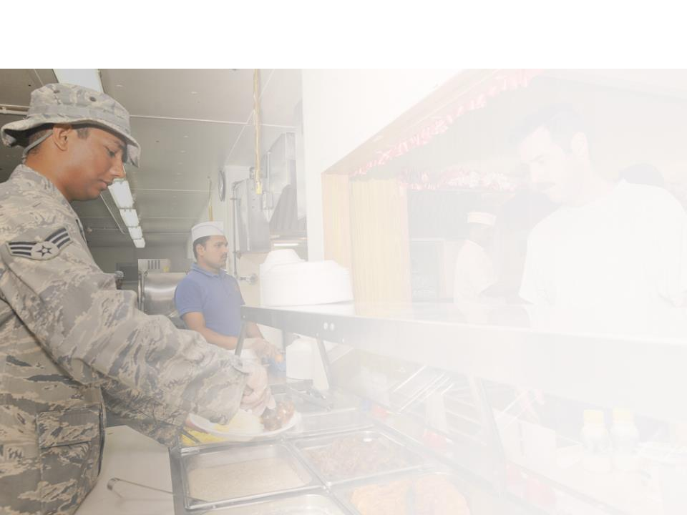
Session IX
DLA Troop Support
Leadership Update
May 24th, 2017
Captain Christopher Mosher, USN
Director of Subsistence
DLA Troop Support
Class I
Subsistence

Slide 2
Making Logistics Happen
Notes:
https://www.youtube.com/watch?v=VFD5K8j_ffA

Slide 3
Agenda
Subsistence Mission
Subsistence Business
Prime Vendor Update
SPV OCONUS Solicitations
Subsistence Program Enhancements

Slide 4
DLA Troop Support Subsistence
Mission
To provide full service subsistence support for the readiness and mobilization needs of U.S. Military personnel and their families worldwide.
Executive Agent for Class I Materiel
Notes:
Mission of Subsistence: As the Class I Executive Agent, our role is to:
Develop and implement plans and procedures for subsistence support
Plan for, procure, manage and supply subsistence
Deliver to locations mutually agreed upon
Maintain and protect war reserve stocks
Achieve greater supply integration by assuming mission transfers as directed

Slide 5
DLA Troop Support Subsistence
The Big Picture
Customers & Items
Sales
Inventory
Personnel & Vendors
FY17 Forecast
$2.39B
$Billions
Customers: 27,000
Orders: 11.7M annually
Items: 50,000
$Millions
Employees (FY16 Actual):
290 civilian + 12 military
Suppliers: CONUS 421 OCONUS 87 508
Notes:
FY17 sales forecast reflects PB18 figure of $2.205B
FY09 FY10 FY11 FY12 FY13 FY14 FY15 FY16
Sales 4.758B 4.713B 4.602B 4.202B 3.445B 2.775B 2.275B 2.268B Obligations 4.488B 4.471B 4.309B 4.414B 2.794B 2.512B 2.022B 2.117B Inventory 471.5M 438.5M 431.3M 444.4M 424.8M 410.1M 448.6M 610M
POC: Roseann Falsetta / Nina DiTomo – sales
Personnel POC: Sharon Szeliga, Amelia McGarvey, Gary Lefebvre, Cathy Kelley
FY15 civ authorization 326 (interns not incl)
FY15 mil auth 13
FY15 business statistics POC: John Graybill Customers: 27,000 Orders: 930k monthly / 11.7M annually Items: 50,000 POC: John Grabill / Leah Aleman
Suppliers: CONUS 421
OCONUS 87
508

Slide 6
FY ’17 Sales
FY17 thru Mar
$1.1B
Notes:
Market Ready (milk, bread, soda) calculated as obs + surcharge (4.6%) and subtracted from total Produce sales figure.

Slide 7
Subsistence Prime Vendor
CONUS | OCONUS
Food Distributor | 3PL companies
Multiple customers in mature industry | Government sole customer
41 contracts… 3rd generation in place | 14 contracts
10 prime vendors Hartford Provision Co, Labatt, Merchants, Nicholas & Co, Pocono Pro Foods, Reinhart, Renzi, Shamrock, Sysco, US Foods | 10 prime vendors Anham, Coastal Pacific, Ebrex, FSI, OFI, Pacific Unlimited Inc, Seven Seas, TWI, USFI, Y Hata
Supports Galleys and Dining Facilities (DFACs), ships and Coast Guard | Supports DFACs, Forward Operating Bases, Mobile Kitchen Trailers, GFM storage and distribution (e.g., MRE)
$767 M FY16 sales | $661 M FY16 sales
Notes:
CONUS supports other non-DoD customers such as Job Corps, US Forestry and Native American Tribes

Slide 8
SPV OCONUS Solicitations
Geographic Area | Estimated contract start date
Korea | Fall ’17
Europe | Winter ’17/’18
Iraq/Kuwait/Jordan | Winter ’17/’18
Japan/Singapore/Diego Garcia/Philippines/Okinawa | Spring ’18
Southern Arabian Peninsula and Eastern Africa | Spring ’18
Afghanistan | Summer ’18

Slide 9
Subsistence Program Enhancements
Situation/Requirement | Current State | *New Enhancements
Customer Engagement for Requirement | Limited | Customer input in development of SOW and participation on Tech Panels
Fill Rates | Varies by contract (97% to 98%); case count fill rate | Fill rate requirement of 98% on all OCONUS contracts; case or line-item fill rate
Residual Inventory | New SPV encouraged to purchase residual inventory | New SPV required to purchase residual inventory (if it has been properly managed)
Not in Stock (NIS) | No trigger point was identified for when OCONUS SPV should plan a direct airlift for NIS items | SPV required to airlift product at contractor expense if NIS projected > 21 days
DOS Requirement | Varied by OCONUS region and not based on line-item | Prescriptive DOS requirements; 60, 75 or 90 DOS per line-item; DOS requirements driven by item shelf life; and customer requirements
Notes:
DOS Requirement
Japan & Okinawa – 60 DOS
Singapore & Philippines – 75 DOS excluding FFV and LMR items. DOS lowered from 90 to 75 due to no homeported ships and few land based customers
Europe Zone 1,2,3 – 60 DOS
Europe Zone 4 (Ships) – 60 (SL < 180) or 90 (SL ≥ 181)
SAPNEA Zone 1 & 2 – 60 (SL < 180) or 90 (SL ≥ 181)

Slide 10
Subsistence Program Enhancements
Situation/Requirement | Current State | *New Enhancements
Local Sourcing | Sourcing of local products OCONUS is encouraged | KO can direct SPV to source local items at no additional cost to the Government
OCONUS CONOPs | Testing was not required | SPV required to have CONOPs plan; CONOPs must be tested after contract implementation
Cybersecurity | No coverage | Pertinent Cybersecurity clauses, reporting requirements, COOP plan, and penetration testing
Joint Buyers Guide | Lack of standardization for requirements | DLA and Services partnered to develop a Joint Buyers Guide
Healthy Initiative | Improvements necessary to achieve Total Force Fitness | DLA is supporting Armed Forces Recipe Division Service with developing healthier menu options
Notes:
Local Sourcing: In the event we are able to waive the Berry Amendment such as in a contingency zone, a KO can direct a SPV to purchase local at no additional cost to the Government. The additional costs are usually transportation costs that now the SPV has to incur. For example, years ago we directed Supreme to purchase bottled water from Uzbekistan however, there were no DTS routes in place so Supreme had to contract with a trucking company to move the products from Uzbekistan into their warehouse in Afghanistan.
Cybersecurity: We are ahead of the DFARS 31 Dec 2017 requirement for contractors to implement Nation Institute of Technology (NIST) SP 800-171 security requirements. Under this requirement, the contractors are required to have a Continuity of Operations (COOP) plan for information systems deemed critical, must allow a third party assessor to perform a security assessment of information systems owned and operated by the contractor, must allow for inspection and penetration testing. In addition, all Cybersecurity requirement flow down to the subcontractors.
JBB: In early February of this year, representatives from Service Headquarters, Natick, DLA, and USDA met in Ft. Lee, VA, to initiate the creation of a Joint Services Buyer’s Guide (JSBG). The JSBG will include not only quality characteristics and attributes, but also include nutritional requirements and parameters, thereby combining individual Service Buying Guides with the DoD Menu Standards. While the original goal of this endeavor was simply to capture and document the Services requirements for all Subsistence Federal Supply Classes (FSCs), this effort has blossomed in to so much more. Due to all participants’ willingness to share knowledge, discuss concerns, and keep an open mind, the Services have partnered on approximately 95% of items, have focused on cleaner, healthier core items (reduced sodium, reduction or elimination of added solutions, etc.), and have identified single products that lend themselves to multiple menu options.
With ongoing regular, recurring teleconferences, the initial version of the Guide, encompassing requirements for FSCs 8905 (beef, pork, veal, lamb, poultry, and seafood sub-primal, portion cut, and further processed items) and 8915 (canned, frozen, and shelf stable fruits, vegetables, and juices) is expected to be published by late June. A final version, documenting all remaining Subsistence FSCs, is expected to be completed by the end of 2017.

Slide 11
US Navy Underway Replenishment
Notes:
https://youtu.be/1aVxe5-FdoI
An Anti-Piracy Grocery Store
Published on Apr 22, 2012
US Navy ships battling pirates off the coast of Somalia can't leave their posts to resupply, so The Peary braves the dangerous seas to deliver much-needed supplies.

Slide 12
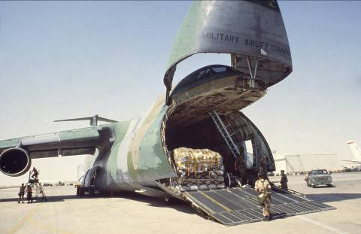
Subsistence Readiness…
We Feed Our Nation’s
Heroes!
Ready, willing & able to meet warfighter needs around the globe

