Slide 1
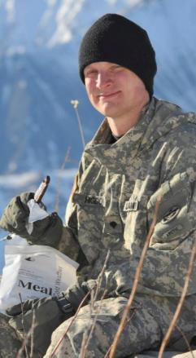
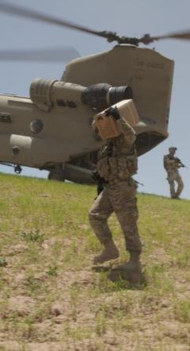
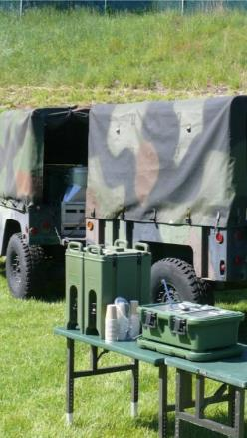
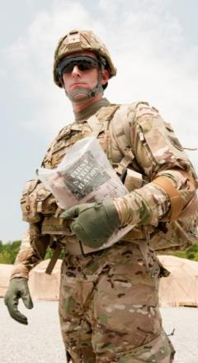





The Leader in Empowering the World’s Most Capable Soldiers
Mission/Purpose
What do we do?
Unitized Group Ration (UGR)-A Workshop
Research & Development Associates Meeting
Sue Harrington
Combat Ration Engineering & Support Team
Marlene.S.Harrington.civ@mail.mil
508-233-4502 / DSN 256-4502

Slide 2
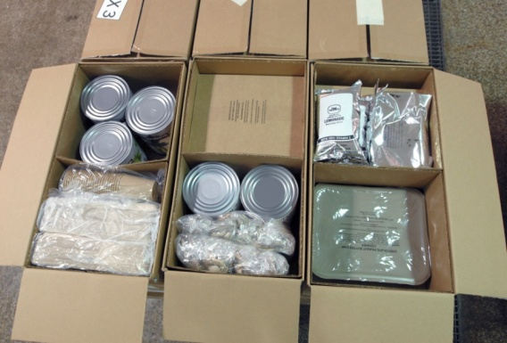
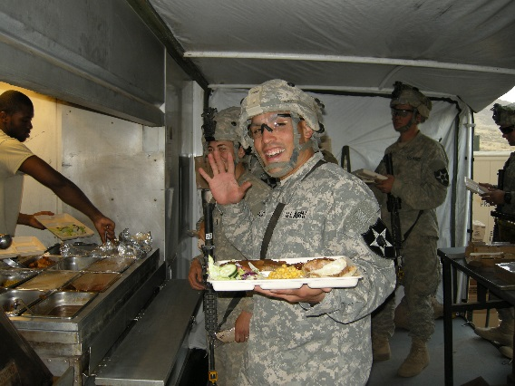
Unitized Group Rations (UGRs)
Family of UGRs:
UGR - Heat and Serve (H&S): shelf stable components; 18 month Shelf-Life @ 80ºF
UGR - A: commercial frozen plus shelf-stable components; 12 month Shelf-Life
UGR - M: USMC specific; shelf-stable ingredients;
18 month Shelf-Life @ 80ºF
Each UGR contains:
  50 complete meals (3 boxes)
  Dining trays, utensils, etc.
  Up to 7 breakfast & 14 lunch / dinner menus
UGR POCs:
UGR-A/M: Sue Harrington
UGR-H&S: Meg Walker
UNCLASSIFIED #U18-189

Slide 3
UGR-A
Menus – Table I
  7 Breakfast
  14 Dinner
  7 Short Order Dinner
Requirements – Table II
http://www.dla.mil/TroopSupport/Subsistence/Operationalrations/ugra.aspx

Slide 4
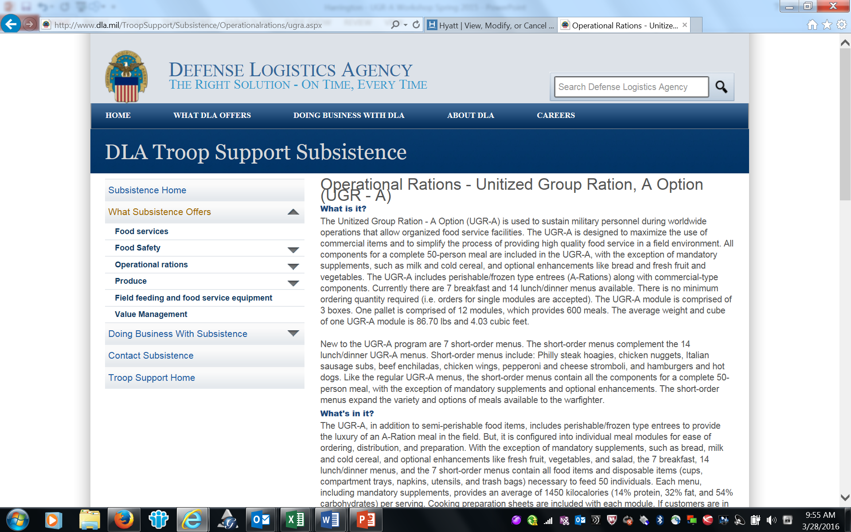
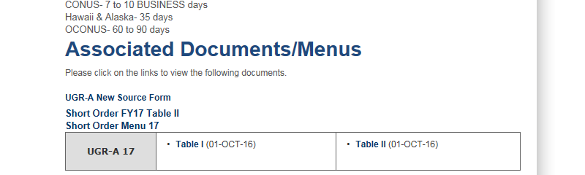
Table I & Table II
http://www.dla.mil/TroopSupport/Subsistence/Operationalrations/ugra.aspx
Scroll to bottom of page for Table I &II
New Source Form
Short Order

Slide 5
UGR-A Table I
UGR-A FY17 TABLE I
BREAKFAST MENU 1 - BREAKFAST TACO/BACON
 | Required Servings and Size |  |  |  | Warranted Shelf Life (mos). | Issue/ | Container Size
Menu Item |  |  | Food/Ingredients/Supplies | Brand |  | 50 Ind.
FROZEN/PERISHABLE BOX - 8970-01-525-6726
ORANGE JUICE | 50 | 8 oz. | Juice, 100% Orange, Frozen Concentrate, Fortified
BACON | 50 | 2 pieces | Bacon, Pork, Precooked, Frozen
TACO SCRAMBLER | 50 | 3 oz. | Taco Scrambler, Precooked, Frozen, Boil-in-Bag
TORTILLA | 50 | 2 each | Tortilla, Flour, Frozen, 6 in. round
GLAZED CINNAMON BITES | 48 | 1.7 oz. | Cinnamon Bites, Glazed, Frozen,
BOX 1 - 8970-01-525-6344
EGGS | 50 | ½ cup | Eggs, Dehydrated, Reduced Cholesterol, Boil-in-Bag
JALAPENO SLICES | 25 | 1.0 oz. pkt. | Jalapeño, Sliced, Shelf-Stable
SALSA | 25 | .5 oz pkt. | Salsa, PC
TOASTER PASTRY | 50 | 1 each | Toaster Pastry, Cinnamon, Whole Grain, Frosted, Individually Wrapped, 1.76 oz.
KETCHUP | 25 | 18 g. pkt. | Ketchup
GRAPE JELLY | 25 | ½ oz pkt. | Jelly, Grape
CHILE LIME HOT SAUCE | 1 | 12 oz.. bottle | Hot Sauce, Chile Lime
 | 1 | 2 oz. | Butter Granules
 | 100 |  | Paper Cups, 8 oz.
BOX 2
OATMEAL | 30 | 1/2 cup | Oatmeal, Quick, 1 minute
COFFEE | 30 | 6 oz. | Coffee, Filter Bag, Arabica
CAPPUCCINO | 20 | 1 pkt. | Cappuccino Beverage Powder, French Vanilla
CREAMERS | 12 | 3 gm pkt. | Creamers, Nondairy
 | 50 |  | Tray, 5-Compartment, Paper
CREAMERS | 24 | 14 g. pkt. | Hazelnut & French Vanilla Packets
 | 50 |  | Dining Packets, Napkin, Knife, Fork, Spoon, Salt/Pepper, Sugar (2)
 | 4 |  | Trash Bags, clear
 | 1 | 1.65 oz. | Salt
 | 1 | .70 oz. | Pepper
 | 1 | 4 oz. | Oil, Vegetable, Butter Flavor
 | 1 | 10 CT | Gloves

Slide 6
Table II

Slide 7
New Item Introduction
Do you have a unique item that is not currently in the UGR-A menu?
  Reference Table II
Does your product meet the requirements for UGR-A
  Shelf Life – minimum of 12 months (frozen or shelf stable)
  Other than main entrée, is product shelf stable?
  Low weight/volume?
  Benefit?
Call or email
If determined that proposed item meets the requirements,
  schedule a visit to demo product
If product meets requirements, then
  Internal review/testing
Field Test

Slide 8
UGR-A New Source Introduction Instructions
To introduce a new source for an existing product in the UGR-A program, assemblers are required to take the following steps:
The UGR-A assembler submits the completed UGR-A New Source Introduction Form to the Defense Logistics Agency – Troop Support (DLA – Troop Support). The form is reviewed and the information is verified to determine if the new items meets the contractual requirements of the Item Description in the UGR-A Table II.
If approved, a DLA-Troop Support Register Number is assigned, and the form with instructions for product submission is returned to the UGR-A assembler who “sponsored” the item.
The UGR-A assembler is required to submit the current Table II approved brand and the New Source brand to Natick. After receipt of both sets of samples, Natick will conduct sensory panels for the New Source and for the approved source that the UGR-A assembler packs. The sensory evaluation results are forwarded to DLA-Troop Support upon completion. DLA-Troop Support responds directly to the UGR-A assembler.

Slide 9
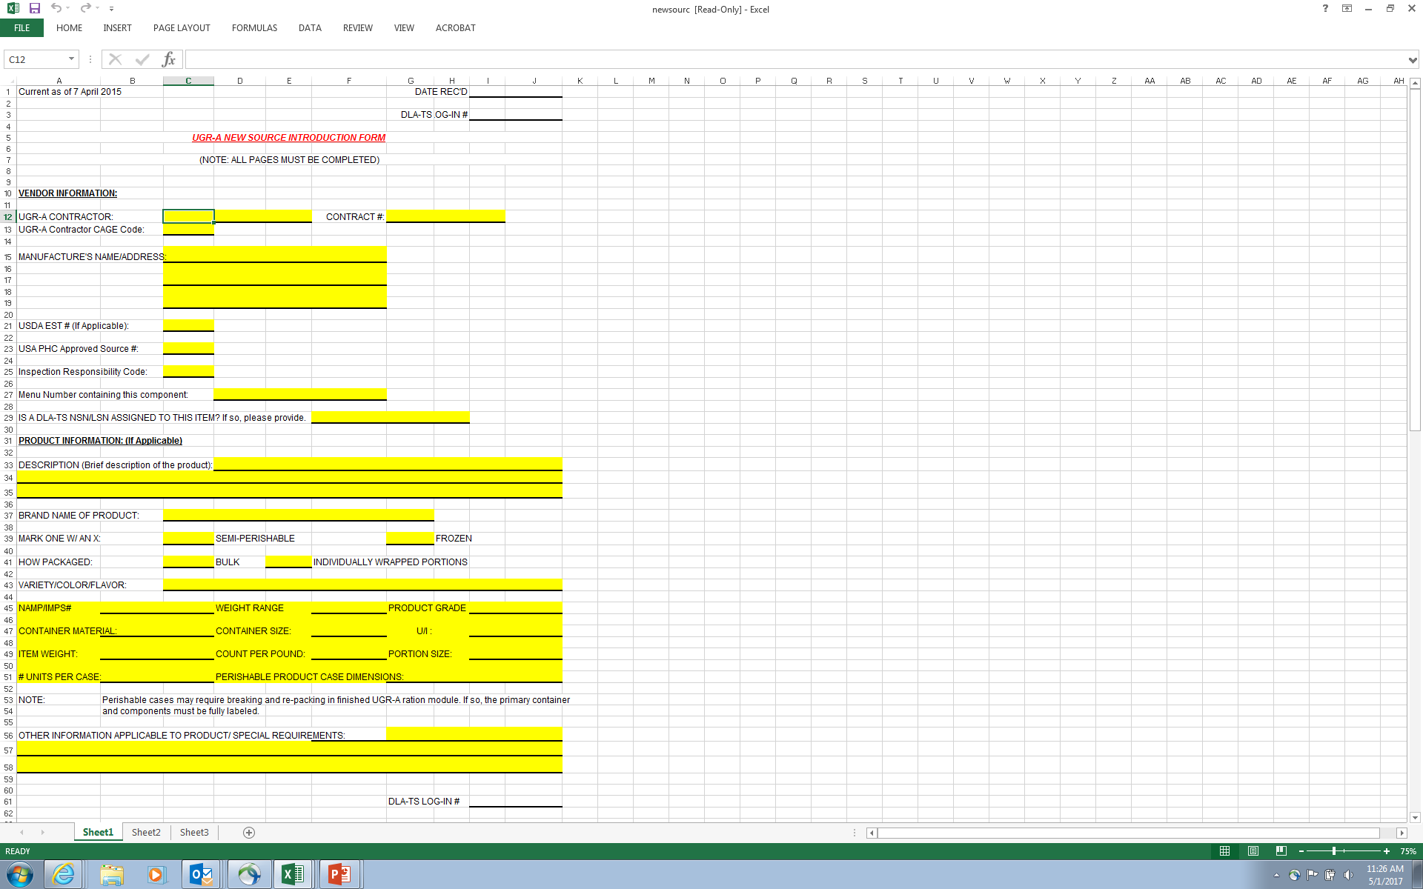
UGR-A New Source Form

Slide 10
UGR-A FY19
Warfighter Feedback Methods
Warfighter Down- selection Process
Purpose: To obtain Warfighter acceptance data on potential new ration components or concepts and down- select items to be included in the Warfighter Field Evaluation
Down-selection testing to be conducted April 2019
Warfighter Operational Field Evaluation
Purpose: To obtain Warfighter acceptance data on a menu and its components in an operational environment
June 2019

Slide 11
Unitized Group Ration – A (UGR-A)
FY19 Field Evaluation Timeline
Potential New Components to Natick
1 Feb 2019
Develop & Coordinate FY21 Table I (menus) and Table II (requirements) April/May 2020
Transition FY21 Tables to DLA-Troop Support for procurement
July/Aug 2020
UGR-A Field Evaluation
June 2019
Present Recommend-ations to JSORF
February 2020
UGR-A FY21 menus available for procurement
1 Oct 2020
Down-Selection of Potential New Components
April 2019
UNCLASSIFIED #U18-189

Slide 12
UGR-A FY19 Warfighter Operational Evaluation
Focus for FY19 Warfighter Operational Test:
  Continue to
    Improve Nutrition
    Reduce Sodium
    Increase Fiber – Legumes, Whole Grains, etc.
    Reduce Fat
    Eliminate Trans-Fats
  Add Vegetarian Options
  Add Seafood Option
  Institutional Sized Pouches (ISP)
  Continue to Standardize the Frozen Module
    Frozen to Shelf Stable where possible
    Optimize components
    Packaging Reductions
  Optimize the amount of secondary components

Slide 13
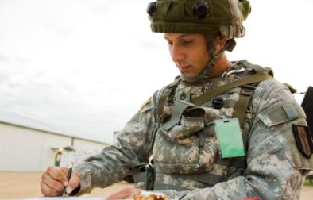
Questions?

